Slide 1

Housing Prices Predictions

Slide 2

TABLE OF CONTENTS
1
2
3
4
5
DATA MINING TECHNIQUES
RESULTS AND FINDINGS
INTRO
PROBLEM
DATASET

Slide 3

PROBLEM
our project aims to solve a problem that most people face when they want to buy a house which is that they cant predict how high a house price can be.
we studied how to accurately predict house prices based on various features provided in our dataset.
This predictive model helps stakeholders, such as real estate agents, buyers, and sellers, in estimating the price of a house given its characteristics

Slide 4
DATASET
Our Dataset is for housing Prices prediction which consists of:
545 object
13 attribute
Price
Area
Bedrooms
Bathrooms
Stories
Guestroom
Basement
Parking
Prefarea
Mainroad
Hot water heating
Furnishing
status
Airconditioning

Slide 5
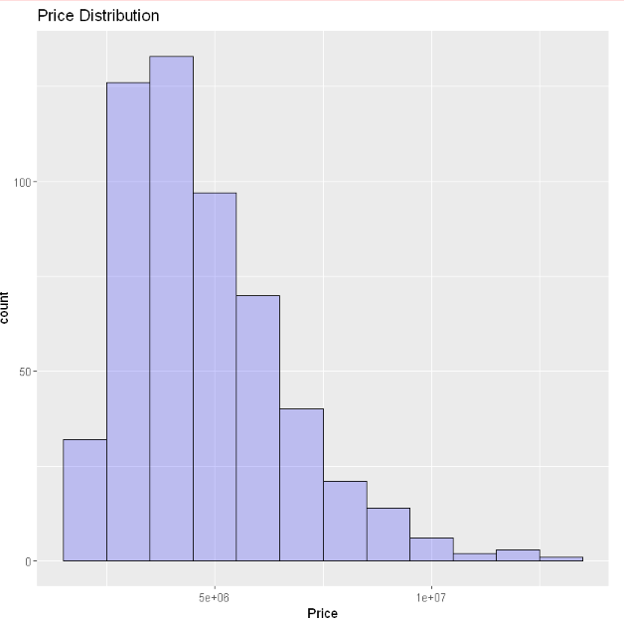
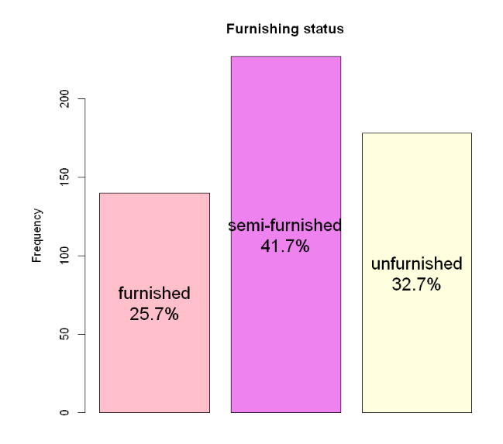
DATA VISUALIZATION

Slide 6
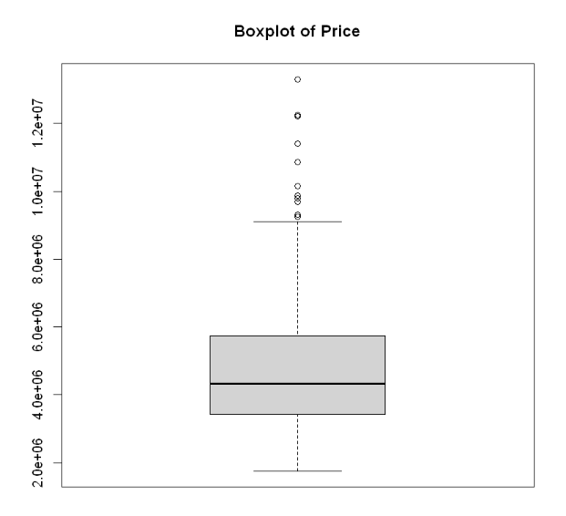
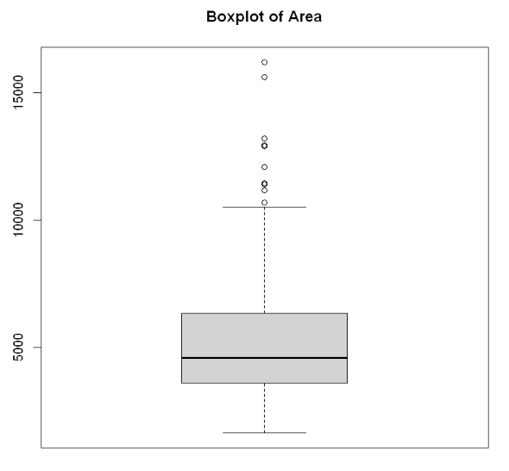
DATA VISUALIZATION

Slide 7


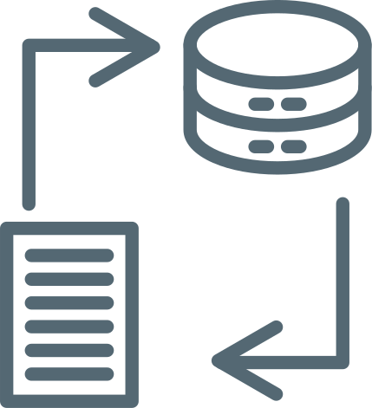
DATA PREPROCESSING
Data cleaning
Data
Transformation
Data cleaning
Data
Transformation
Feature selection
Feature selection

Slide 8
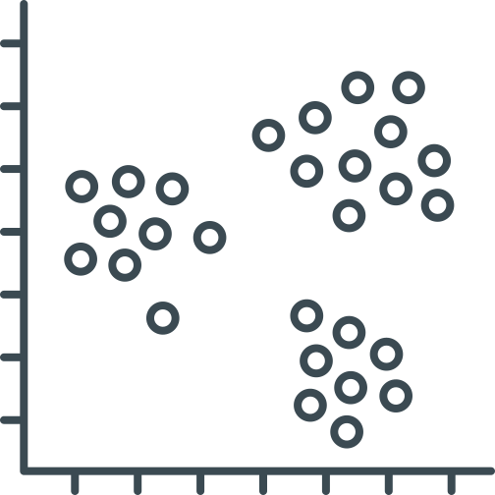

DATA MINING TECHNIQUES
We have used two Data mining techniques to make our predictions on house prices which are:
Classification
Clustering
As a supervised technique.
As an unsupervised technique.

Slide 9
CLASSIFICATION
Classification is the task of assigning labels to data based on its features which is a supervised learning technique, in our case the class label is “price” and the classes are either “low” or “high”.
we used the following partitions:
70-30 split
80-20 split
90-10 split

Slide 10
CLASSIFICATION
To perform classification we implemented 3 algorithms on each partition to construct and evaluate 9 models in total.
The algorithms: Information Gain(ID3), Gain Ratio(C5.0), and Gini index(CART).
70-30 split
80-20 split
90-10 split
IG
IG Ratio
Gini Index
IG
Gini Index
IG
Gini Index
IG Ratio
IG Ratio

Slide 11
CLUSTERING
Clustering is a method in unsupervised machine learning that groups similar data points together.
We used K-means technique that represents the clusters by the center of cluster
k=2
k=4
k=8

Slide 12
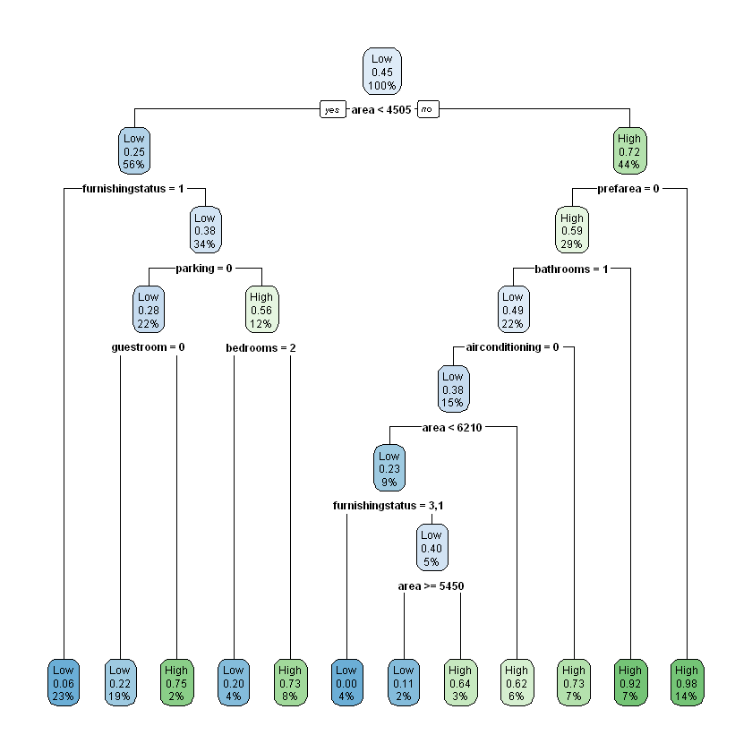
FINDINGS
the best decision tree among the rest is the gini index 80-20 split.
it was chosen for having one of the highest accuracies and the most balanced high values.
from the graph the value “Low” is the blue color and “High” is the green.

Slide 13
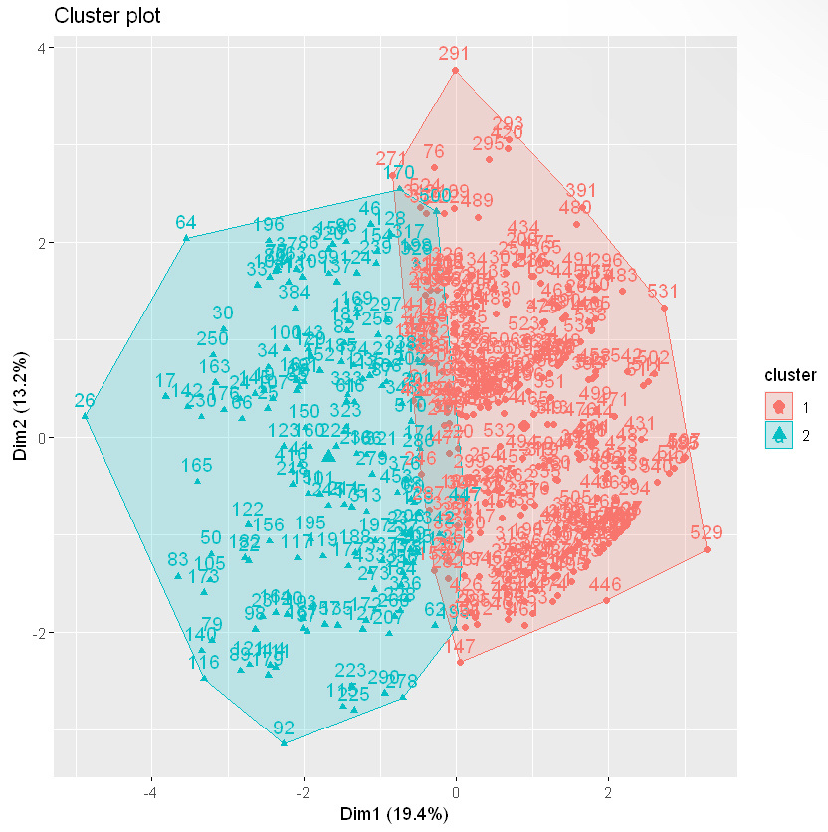
FINDINGS
the best result we got was k=2 .
we chose k=2 because of it’s performance and it has the highest average silhouette width.
and it has the least overlapping comparing to other clusters.

Slide 14


THANK YOU
Have any question?

